Slide 1
The Pigeonhole Principle
CS 131 – Fall 2021 Semester Project
By: Allan Orozco

Slide 2
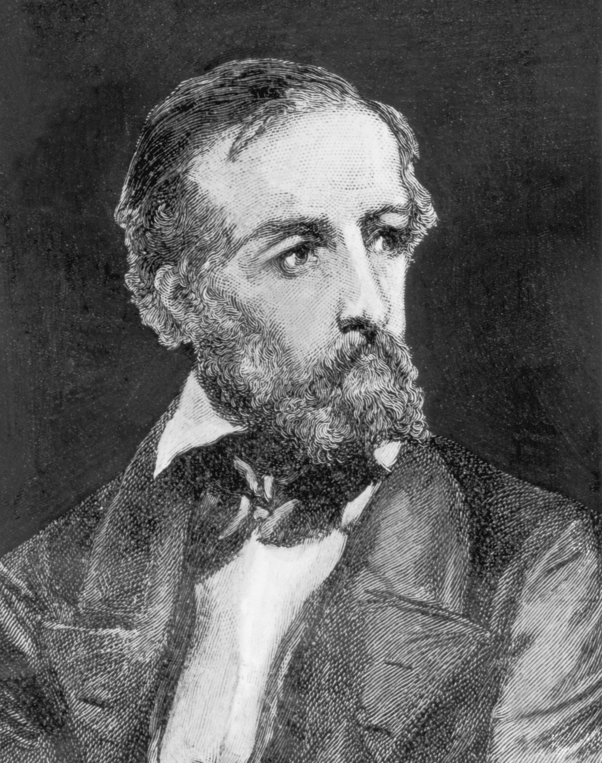
The Pigeonhole Principle
The Pigeonhole principle is also called the Dirichlet drawer principle, after the nineteenth century German mathematician G. Lejeune Dirichlet.
Peter Gustav Lejeune Dirichlet

Slide 3
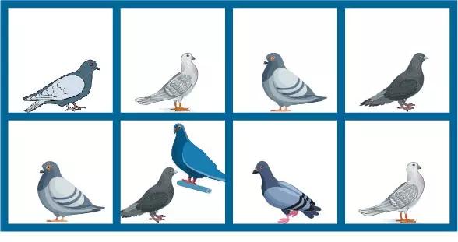
What is the Pigeonhole Principle ?
The pigeonhole principle states that if there are more pigeons than pigeonholes, then there must be at least one pigeon with at least two pigeons in it.
This principle is extremely useful and applies to much more than just pigeons and pigeonholes.
Theorem1: If k is a positive integer and k + 1 or more objects are placed into k boxes, then there is at least one box containing two or more of the objects

Slide 4
the pigeonhole principle
Mapping Rule: total injection from A to B implies |A|<= |B|
If |A|>|B|, then no total injection from A to B

Slide 5
examples on how its used
Example 1
Among any group of 367 people, there must be at least two with the same birthday, because there are only 366 possible birthdays.
Example 2
How many students must be in a class to guarantee that at least two students receive the same score on the final exam, if the exam is graded on a scale from 0 to 100 points?
There are 101 possible scores on the final. The pigeonhole principle shows that among any 102 students there must be at least 2 students with the same score

Slide 6
The Generalized Pigeonhole Principle
If N objects are placed into k boxes, then there is at least one box containing at least [N/k] objects.
Proof by Contraposition:
Suppose that none of the boxes contains more than [N/k] – 1 objects. Then, the total number of objects is at most:
k ( [N/k] – 1) < k ((N/k + 1) – 1) = N
- Where the inequality [N/k] < (N/k) + 1 has been used. Meaning the total number of objects is less than N

Slide 7
The Generalized Pigeonhole Principle
Example
What is the minimum number of students required in a discrete mathematics class to be sure that at least six will receive the same grade, if there are five possible grades, A, B, C, D, and F?
Solution
[N/5] = 6
N = 5 * 5 + 1
= 26, is the minimum number of students needed to ensure that at least six students will receive the same grade.

